Slide 1

Data Mining Final Project Pitchbook Industry Classification: Robust ML for Classification for Investment Banking
March 9, 2023
Qingwei Zhang
Tejumade Oyedele
Jacob Brewer
Prinu Mathew

Slide 2
Table of Contents
Background
Key Stakeholders & Project Overview
Background & Goals
Application Architecture
Current & Proposed
Methodology
Data Collection and Preprocessing
Data Exploration & Feature Engineering
Data Mining Techniques
Results and Evaluation
Conclusion
References

Slide 3
Key Stakeholders
Project Overview
Background
Architecture
Methodology
Outcome
Conclusion
Investment bankers: They are the primary stakeholders and use industry classification to identify promising companies and sectors for investment, compare valuation metrics across different industries, and diversify their portfolios across different sectors
Corporate executives: Use industry classification to identify market trends, analyze competitors, and make informed decisions about new business ventures or investments.
Investors: Investors are also stakeholders and use industry classification to identify companies with strong growth potential, analyze market trends, and make informed decisions about portfolio allocation.
Regulators: Regulators are also stakeholders for industry classification in investment banking, as they use industry data to monitor compliance with regulations and guidelines.
Notes:
Investment bankers: Investment bankers are the primary stakeholders for industry classification in investment banking, as they rely on industry data to source deals, value companies, and manage portfolios. Investment bankers use industry classification to identify promising companies and sectors for investment, compare valuation metrics across different industries, and diversify their portfolios across different sectors.
Corporate executives: Corporate executives are also stakeholders for industry classification in investment banking, as they use industry data to make strategic decisions for their companies. Corporate executives use industry classification to identify market trends, analyze competitors, and make informed decisions about new business ventures or investments.
Investors: Investors are stakeholders for industry classification in investment banking, as they use industry data to make investment decisions. Investors use industry classification to identify companies with strong growth potential, analyze market trends, and make informed decisions about portfolio allocation.
Regulators: Regulators are also stakeholders for industry classification in investment banking, as they use industry data to monitor compliance with regulations and guidelines.

Slide 4
Project Overview
Background
Architecture
Methodology
Outcome
Conclusion
Project Overview
Industry classification from PitchBook data can help business users in Investment Banking in several ways:
Deal sourcing: Investment banks rely on deal flow to generate revenue, and industry classification can help banks to identify promising companies or sectors for investment.
Valuation: Industry classification can also be useful for company valuation, as different industries may have different valuations based on market trends and other factors.
Market research: Industry classification can be useful for market research, as it allows banks to identify trends and patterns in different industries.
Portfolio management: Industry classification can be useful for portfolio management, as it allows banks to diversify their investments across different industries and reduce risk.
Regulators: Use industry classification to identify trends and patterns in different industries, and to ensure that investment banks are operating within regulatory requirements.
Notes:
Deal sourcing : Machine learning can be used to classify companies based on their industry, allowing banks to target their deal sourcing efforts more effectively
Valuation : Machine learning can be used to classify companies based on their industry, allowing banks to compare valuation metrics across different industries and make more informed investment decisions
Market research: Machine learning can be used to classify companies based on their industry, allowing banks to analyze market data and make informed predictions about future market trends
Portfolio management: Machine learning can be used to classify companies based on their industry, allowing banks to optimize their portfolio allocation and balance risk and return
Regulators: Use industry classification to identify trends and patterns in different industries, and to ensure that investment banks are operating within regulatory requirements.

Slide 5
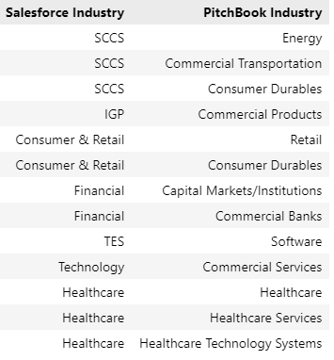
Background
Project Overview
Background
Architecture
Methodology
Outcome
Conclusion
100s –1000s of companies exist belonging to various industries. Today these are manually categorized by investment banking business users in financial firm using the domain experience and grouped under various industry classification schemes like NAICS, SIC, NIC, etc. and tracked in their internal Salesforce CRM repository. Below are some of the examples of manual mapping between Salesforce CRM and PitchBook industry classification
Question: Can we create a more dynamic categorization basis the journey of a company using a machine learning model?
Answer: Yes, we can!. And that’s what we are going to explore in subsequent slides

Slide 6


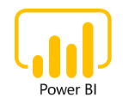


Existing Application Architecture
Project Overview
Background
Architecture
Methodology
Outcome
Conclusion
Data Sources
Manual Ops
Business users manually identify the Industry classifier based on domain knowledge and company description from Pitchbook data and update the company records in Salesforce CRM
4
1
Manual Industry Classification Process
Pull Pitchbook
Data
Custom Web App
Read Data from Storage
Write Classification Data to Storage
2
Pull Salesforce
Data
Write to Storage
5
Consume data for reporting
ETL Workspace
3
6
7
Write Data to CRM
Big Data Storage

Slide 7

Proposed Application Architecture
Project Overview
Background
Architecture
Methodology
Outcome
Conclusion
Data Sources
MLOps
Fine tunned Machine Learning model that predict the industry classification based on company description plus other attributes from Pitchbook data and update the company records in Salesforce CRM
4
1
Model Development (Industry Classification)
Pull Pitchbook
Data
Jupyter
Workspace
Iterate
Raw
Data
EDA
Feature
Engineering
Model
Train
Evaluate
Model
Read Data from Storage
Write Classification Data to Storage
2
Pull Salesforce
Data
Write to Storage
5
Consume data for reporting
ETL Workspace
3
6
7
Write Data to CRM
Big Data Storage

Slide 8
Project Overview
Background
Architecture
Methodology
Outcome
Conclusion
Data Science Development Journey
We need MLOps!
Problem
Definition
Data
Sourcing
Data Preparation
Improve
Model
Training
Model Evaluation
Model Deployment
Model Inferencing

Slide 9
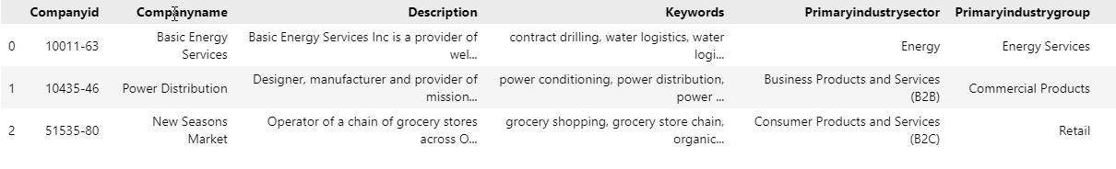
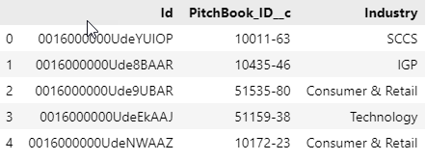
Data Collection
Project Overview
Background
Architecture
Methodology
Outcome
Conclusion
The following are the snapshot of data sources, assuming the real data from PitchBook and Salesforce are available in big data storage platform through the data engineering processes
PitchBook Data
Salesforce Data

Slide 10
Data Preprocessing (EDA)
Project Overview
Background
Architecture
Methodology
Outcome
Conclusion
First, the text data from PitchBook and Salesforce are preprocessed as follows
Merge two datasource based on ‘companyId’ column
Drop all observations that are having missing values based on ‘description’ column
Dropping all PitchBook companies that are mapped to multiple Salesforce records using ‘companyId’ column. This is to avoid biases during the model training
PitchBook descriptions will be features (predictors), Salesforce industries will be labels (response). Then we move on to feature engineering stage
Notes:
EDA – Exploratory data analysis

Slide 11
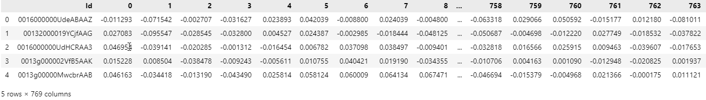
Feature Engineering
Project Overview
Background
Architecture
Methodology
Outcome
Conclusion
After preprocessing, the data from PitchBook are feature engineered as follows
PitchBook provides multiple columns like ‘Description’, ‘Keywords’, ‘PrimaryIndustrySector’, ‘PrimaryIndustryGroup’, ‘PrimaryIndustryCode’ that describes the company as well as the industry it belongs to. This columns are not aligned to company description from Salesforce side. We combine all those columns from Pitchbook into one column ‘CompleteDescription’ and call it has sentence, so it can help in extracting meaningful insights using NLP tools
Then for each sentence, we use BERT Sentence Transformers, that encode the meaning and context of a sentence into a dense vector representation called embeddings shown below, which can better capture the nuances of that sentence. Below snapshot represent fixed length for each input sentence and length of the vector depends on the specific pre-trained model used, but it is typically 768, 1024, or 2048. Here each Id reference to a actual sentence
Notes:
PitchBook provides multiple columns like ‘Description’, ‘Keywords’, ‘PrimaryIndustrySector’, ‘PrimaryIndustryGroup’, ‘PrimaryIndustryCode’. We combine all those columns from Pitchbook into one column ‘CompleteDescription’ and call it has sentence.
Improved Sentence Representations: Traditional methods of sentence representation, such as bag-of-words or simple word embeddings, may not capture the full meaning and context of a sentence. Sentence transformers, on the other hand, are designed to encode the meaning and context of a sentence into a dense vector representation, which can better capture the nuances of the sentence.
The sentence transformers output a dense vector representation of fixed length for each input sentence. The length of the vector depends on the specific pre-trained model used, but it is typically 768, 1024, or 2048. For example, the popular BERT model uses a vector length of 768.
The reason for using a fixed-length vector representation is that it allows us to compare and measure the similarity between different sentences in a consistent way. This is important for many NLP tasks, such as information retrieval, document classification, and question answering.
The individual values in the output vector represent the learned features or attributes of the sentence, which are determined by the pre-trained model. These features can capture various aspects of the sentence, such as its syntax, semantics, context, and sentiment.
Overall, the sentence transformer output vector is a powerful tool for encoding the meaning and context of a sentence into a dense, fixed-length representation that can be used in a wide range of NLP applications.

Slide 12
Feature Engineering
Project Overview
Background
Architecture
Methodology
Outcome
Conclusion
What is Sentence embedding?
Sentence embedding is often used in sentence transformation tasks to compare the meaning of different sentences or to generate new sentences that have similar meanings. It refers to the process of converting a sentence into a numerical vector representation. This vector representation captures the meaning and context of the sentence in a way that can be used by machine learning algorithms for various natural language processing (NLP) tasks, such as text classification, sentiment analysis, and language translation.
There are different approaches to sentence embedding, including:
Bag-of-Words: In this approach, the sentence is first preprocessed to remove stop words, punctuation, and other irrelevant elements. Then, the bag-of-words technique is used to represent the sentence as a vector of word frequencies. The resulting vector is used as the vector representation of the sentence.
Bag-of-words Embedding
Sentence
Text Preprocessing
Bag-of-Words Encoding
Vector Representation

Slide 13
Feature Engineering
Project Overview
Background
Architecture
Methodology
Outcome
Conclusion
What is Sentence embedding?
Word Embeddings: This approach represents each word in a sentence as a vector in a high-dimensional space, where words that have similar meanings are closer together. The sentence is then represented as a vector that is the sum or average of the word vectors in the sentence.
Transformers: This approach uses deep neural networks to encode a sentence as a fixed-length vector. Transformers have achieved state-of-the-art performance on many NLP tasks, including sentence classification and language modeling.
Word Embedding
Sentence
Text Preprocessing
Word Embedding Encoding
Sentence Vector Representation
Transformers Embedding
Sentence
Text Preprocessing
Transform Encoding
Sentence Vector Representation

Slide 14
Data Mining Techniques
Project Overview
Background
Architecture
Methodology
Outcome
Conclusion
Sentence transformers with Logistic Regression for sentence classification
The purpose of using sentence transformers in Logistic Regression is to improve the quality of the sentence representation in PitchBook data source and enhance the performance of the classification model.
First, the text data is preprocessed to remove stop words, punctuation, and other irrelevant elements from PitchBook data.
The preprocessed text is then encoded using a pre-trained sentence transformer model such as SBERT.
The resulting sentence embeddings are fed into a Logistic Regression model to train and make predictions.
During the training process, the Logistic Regression model learns to classify the sentences based on their vector representations, which capture the meaning and context of the sentence.
During the prediction process, the trained model takes as input the new sentence, encodes it using the same sentence transformer model, and predicts its class label based on the learned classification rules.
Merge inferenced class label to Salesforce CRM
Notes:
Sentence transformers can be used in conjunction with Logistic Regression for various natural language processing (NLP) tasks that involve sentence classification. The purpose of using sentence transformers in Logistic Regression is to improve the quality of the sentence representation and enhance the performance of the classification model.
In traditional Logistic Regression models for sentence classification, the sentence is represented as a bag-of-words or a sequence of word embeddings, which can lead to the loss of important semantic and contextual information. Sentence transformers address this limitation by encoding the sentence as a dense vector that captures the meaning and context of the sentence.
By using sentence transformers in Logistic Regression, we can achieve state-of-the-art performance on various NLP tasks such as sentiment analysis, text classification, and language translation.

Slide 15

Data Mining Techniques
Project Overview
Background
Architecture
Methodology
Outcome
Conclusion
Machine Learning Operation (MLOps)
Model Development Journey (Industry Classification)
3
Feature Engineering
Model Training & Evaluation
Model Inferencing
Sentence
Input Best Model
Parameters
Input Test Data
10
Preprocessing
2
7
PitchBook Descriptions
Sentence Vector Representation
Cross Validation (GridSearchCV)
Logistic
Regression
Model Performance
Model Prediction
Transform Encoding
6
8
Text Preprocessing
Read PitchBook and Salesforce Raw Data
Integrate Industry Classification to
Salesforce CRM records
Read vector embeddings
Save Trained Model
Read Trained Model and Real Data
Save vector embeddings
Save Final
Model Metrics
13
5
11
12
1
4
9
Big Data Storage
Notes:
Read PitchBook and Salesforce data from big data storage account platform
Preprocessing component merges the PB and SF data based on ‘CompanyId’ and remove any duplicates companies that are tied to SF records. All description related columns are passed to feature engineering component
Feature Engineering component combines all description columns like Description, Keywords, Primary industry sector, group and code from PB data and creates a new column ‘CompleteDescription’
Each ‘CompleteDescription’ called sentence from PitchBook observation is inputted to SBERT sentence transformers
Sentence transformers transform the sentence to encoding and output a dense vector representation of fixed length for each input sentence. The length of the vector depends on the specific pre-trained model used, but it is typically 768, 1024, or 2048. Here in our project, we uses a vector length of 768.
The reason for using a fixed-length vector representation is that it allows us to compare and measure the similarity between different sentences (complete description from PitchBook) in a consistent way
The individual values in the output vector represent the learned features or attributes of the sentence, which are determined by the pre-trained model. These features can capture various aspects of the sentence, such as its syntax, semantics, context, and sentiment.
Sentence embeddings are then saved in storage account for further processing
Read sentence embeddings of all PitchBook observation and Salesforce industry classifier labels from storage account for Cross Validation
Here sentence embeddings will be features (predictors), Salesforce industries will be labels (response). Split the data into train and test. 70% for train and 30% for test
Cross-validation is a statistical technique used to evaluate the performance and robustness of a machine learning model. It involves splitting the available data into multiple folds, where each fold is used for training the model and the remaining fold is used for validation. This process is repeated multiple times, with each fold used for validation exactly once. By doing this, we can get a more accurate estimate of how well the model will perform on new, unseen data.
GridSearchCV is a specific type of cross-validation technique that involves testing a range of hyperparameters for a given model to find the combination that results in the best performance. Hyperparameters are parameters of the model that are not learned from the data, but rather set by the user. For example, the regularization and solver parameters in logistic regression
The reason we use cross-validation and GridSearchCV together is to ensure that our model is not overfitting or underfitting the data, and to optimize the hyperparameters to achieve the best performance. Cross-validation helps us evaluate the performance of the model on different subsets of the data, and GridSearchCV helps us find the best hyperparameters for the model. Without cross-validation, we may be overestimating the performance of the model, and without GridSearchCV, we may be using suboptimal hyperparameters that result in poor performance
Best hyper tuning parameters for regularization and solver are passed to supervised learning algorithm
Since our business goal is to predict industry classifier from PitchBook descriptions based on existing labels, we need to use classification algorithm that supports multiple labels
Here we use Logistic Regression has a supervised learning algorithm meaning that it requires labeled training data to make predictions on new, unseen data
In the case of Logistic Regression, the algorithm is trained on a set of input features (i.e., vector embeddings of 768 columns) and their corresponding categorical labels (Salesforce industries). The algorithm learns to estimate the probability of belonging to each class, based on the input features. This probability estimate can then be used to make predictions on new, unseen examples
Save the trained model to storage account
Pass the unseen test data to trained model
Predict probabilities from trained model using test data, model performance metric like accuracy score, confusion matrix are analyzed and then saved in storage account for reporting purpose
Finally new company descriptions from PitchBook real datasource are inferenced using model endpoint and the predicated industry classification are tagged to Salesforce CRM based on Salesforce Id and PitchBook company Id

Slide 16
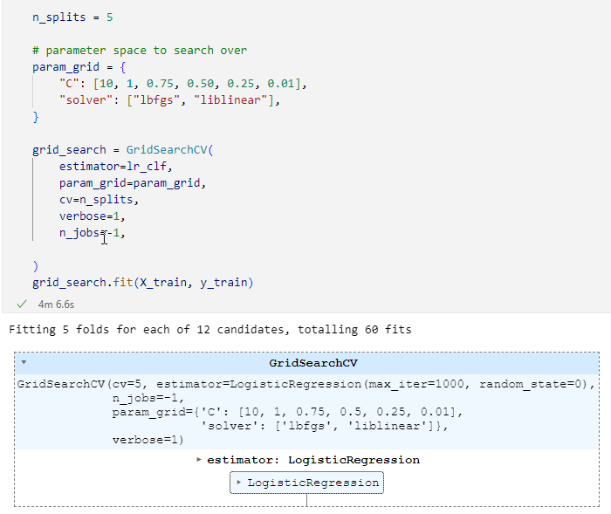
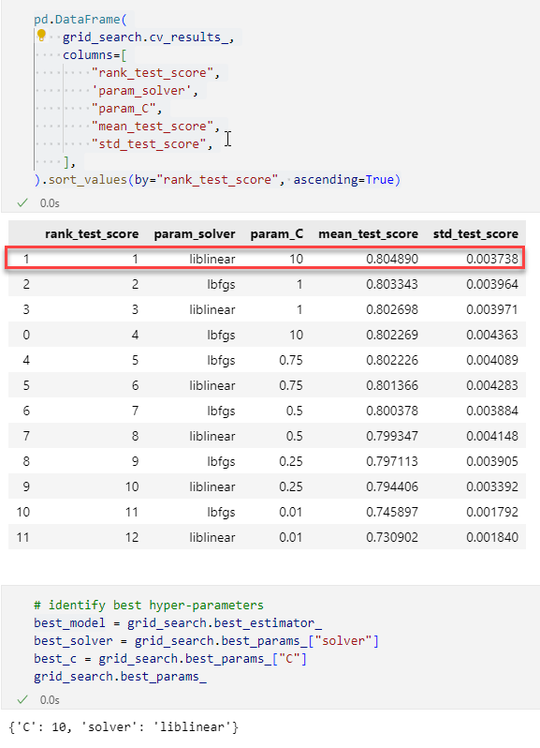
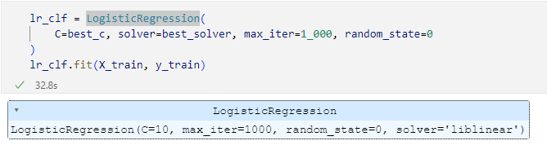
Data Mining Techniques
Project Overview
Background
Architecture
Methodology
Outcome
Conclusion
Cross Validation and Logistic Regression
Model Development Journey (Industry Classification)
2
Model Training
Determine Best
Model Parameters
Input Best Model Parameters
3
Cross Validation (GridSearchCV)
Logistic
Regression
2
4
Read vector embeddings
Save Trained Model
Input Best Model Parameters to Logistic Regression
1
5
4
Big Data Storage
Notes:
Read sentence embeddings of all PitchBook observation and Salesforce industry classifier labels from storage account for Cross Validation
Here sentence embeddings will be features (predictors), Salesforce industries will be labels (response). Split the data into train and test. 70% for train and 30% for test
Cross-validation is a statistical technique used to evaluate the performance and robustness of a machine learning model. It involves splitting the available data into multiple folds, where each fold is used for training the model and the remaining fold is used for validation. This process is repeated multiple times, with each fold used for validation exactly once. By doing this, we can get a more accurate estimate of how well the model will perform on new, unseen data.
GridSearchCV is a specific type of cross-validation technique that involves testing a range of hyperparameters for a given model to find the combination that results in the best performance. Hyperparameters are parameters of the model that are not learned from the data, but rather set by the user. For example, the regularization and solver parameters in logistic regression
The reason we use cross-validation and GridSearchCV together is to ensure that our model is not overfitting or underfitting the data, and to optimize the hyperparameters to achieve the best performance. Cross-validation helps us evaluate the performance of the model on different subsets of the data, and GridSearchCV helps us find the best hyperparameters for the model. Without cross-validation, we may be overestimating the performance of the model, and without GridSearchCV, we may be using suboptimal hyperparameters that result in poor performance
Best hyper tuning parameters for regularization and solver are passed to supervised learning algorithm
Since our business goal is to predict industry classifier from PitchBook descriptions based on existing labels, we need to use classification algorithm that supports multiple labels
Here we use Logistic Regression has a supervised learning algorithm meaning that it requires labeled training data to make predictions on new, unseen data
In the case of Logistic Regression, the algorithm is trained on a set of input features (i.e., vector embeddings of 768 columns) and their corresponding categorical labels (Salesforce industries). The algorithm learns to estimate the probability of belonging to each class, based on the input features. This probability estimate can then be used to make predictions on new, unseen examples

Slide 17
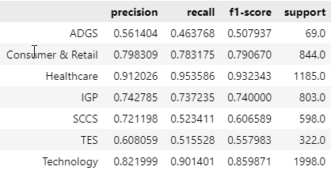
Results and Evaluation
Project Overview
Background
Architecture
Methodology
Outcome
Conclusion
Using the best hyperparamaters from the gridsearch cross validation , we generated predictions for our test data. Our model was able to predict accurately for 80% of our test data. Our overall model accuracy score was 0.81.
We found out that Healthcare sector performed best with f1 score of 0.93, followed by 0.85 for Technology and ADGS performed worse with an F1 score of 0.51 as shown. This means given Pitchbook data, our model will accurately classify industries in the healthcare & technology sector best when compared to other industries.

Slide 18
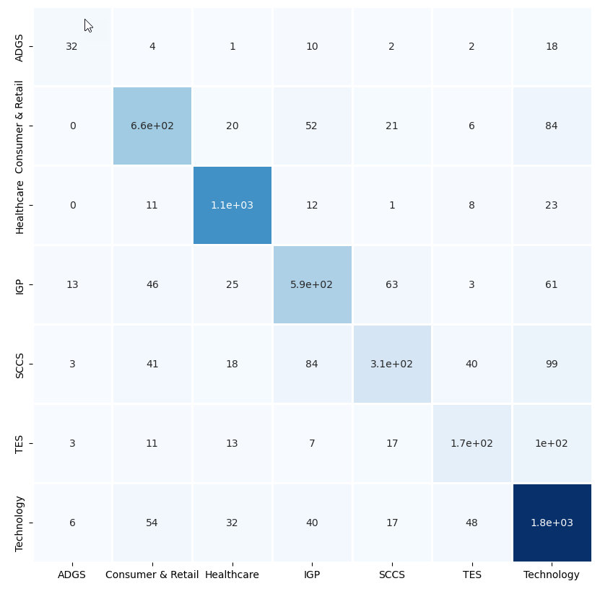
Results and Evaluation
Project Overview
Background
Architecture
Methodology
Outcome
Conclusion
As shown from the confusion matrix we can see the counts for the true positives i.e correct predictions is high compared to the counts of the wrong predictions given a sector for the different sectors.
Most of the wrong predictions for all the variables were classified as Technology while other variables were least likely to be predicted as ADGS.
Overall, our model performed well as shown from the different metrics but can be improved upon.

Slide 19
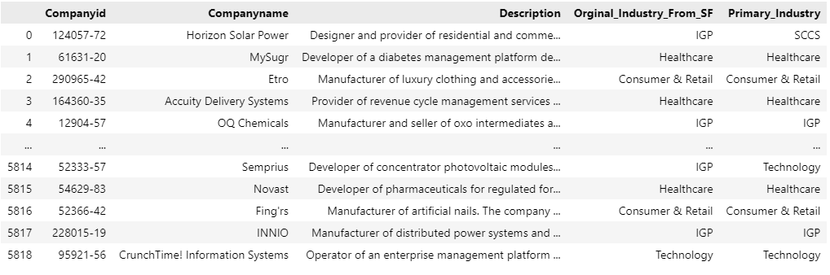
Inferencing Pitchbook Industry Classification
Project Overview
Background
Architecture
Methodology
Outcome
Conclusion
PitchBook data streamed real-time are preprocessed, feature engineered and inputted to inference model endpoint and the predicted industry classification are merged to Salesforce CRM as ‘Primary_Industry’ column. Also, you can see how close the accuracy is with custom mapped industry label column ‘Orginal_Industry_From_SF’ in Salesforce

Slide 20
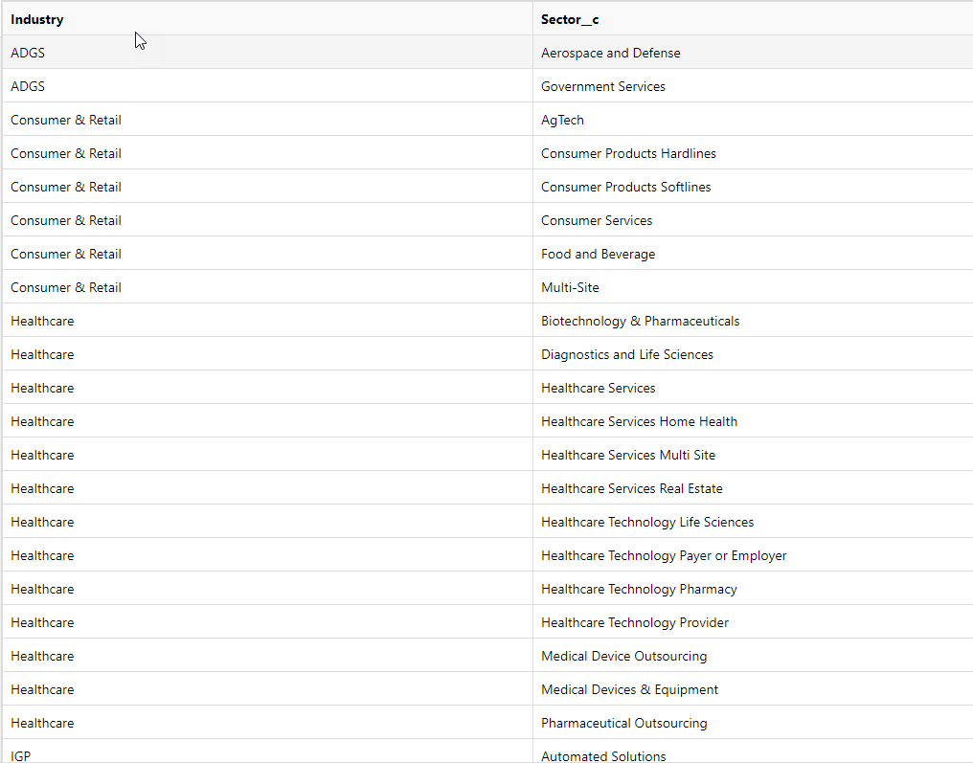
Conclusion
Project Overview
Background
Architecture
Methodology
Outcome
Conclusion
Using Logistic Regression, we were able to infer the industry classification with 80% accuracy from PitchBook descriptions
We can go further with predicting sector and sub-sector labeling as shown below based on inputs from industry classification and using Sentence transformers and Logistic Regression
Overall, industry classification from PitchBook data using Logistic Regression can provide business users in Investment Banking with valuable insights and decision support, helping them to source deals, value companies, conduct market research, and manage their portfolios effectively

